Slide 1

DEPARTMENT OF ARTIFICIAL INTELLIGENCE AND DATA SCIENCE
Disease prediction & Suggest medicine’s
Mr. Ganesan G
ASP/AI and DS
Name of the project team with Roll no:
A Kabilan -721921243055
C Indiran -721921243051
T Hari Prasath -721921243048
R Hari Prasath -721921243049

Slide 2
S.No | CONTENT | SLIDE NO.
1. | INTRODUCTION | 03-04
2 | LITERATURE SURVEY | 05-08
3. | PROBLEM IDENTIFICATION | 09-11
4. | AIM & OBJECTIVE | 12-13
5 | PROPOSED METHOD | 14-17
6. | EXPECTED OUTCOME | 18-19

Slide 3
1. INTRODUCTION
1.1 Overview
Healthcare is undergoing a transformation with the integration of Artificial Intelligence (AI) and Machine Learning (ML) to predict diseases and recommend medicines. Early detection of diseases plays a crucial role in reducing mortality rates and improving healthcare outcomes.
1.2 Importance of AI in Healthcare
AI models can analyze vast amounts of patient data to detect patterns.
Machine learning algorithms help in early diagnosis, improving survival rates.
AI-based medicine recommendation systems ensure proper treatment.

Slide 4
1.3 Need for Disease Prediction Systems
Traditional diagnosis methods often rely on doctors' expertise, which can lead to delayed or incorrect diagnoses. AI-based systems can:
Provide automated, data-driven insights.
Reduce the risk of human error.
Assist healthcare professionals in making informed decisions.

Slide 5
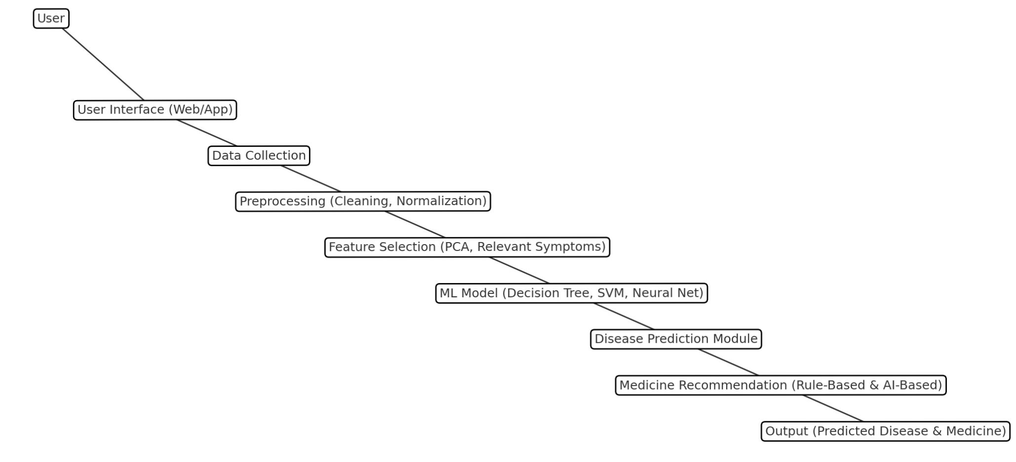
System Architecture Diagram for AI based disease prediction and suggest medicine

Slide 6
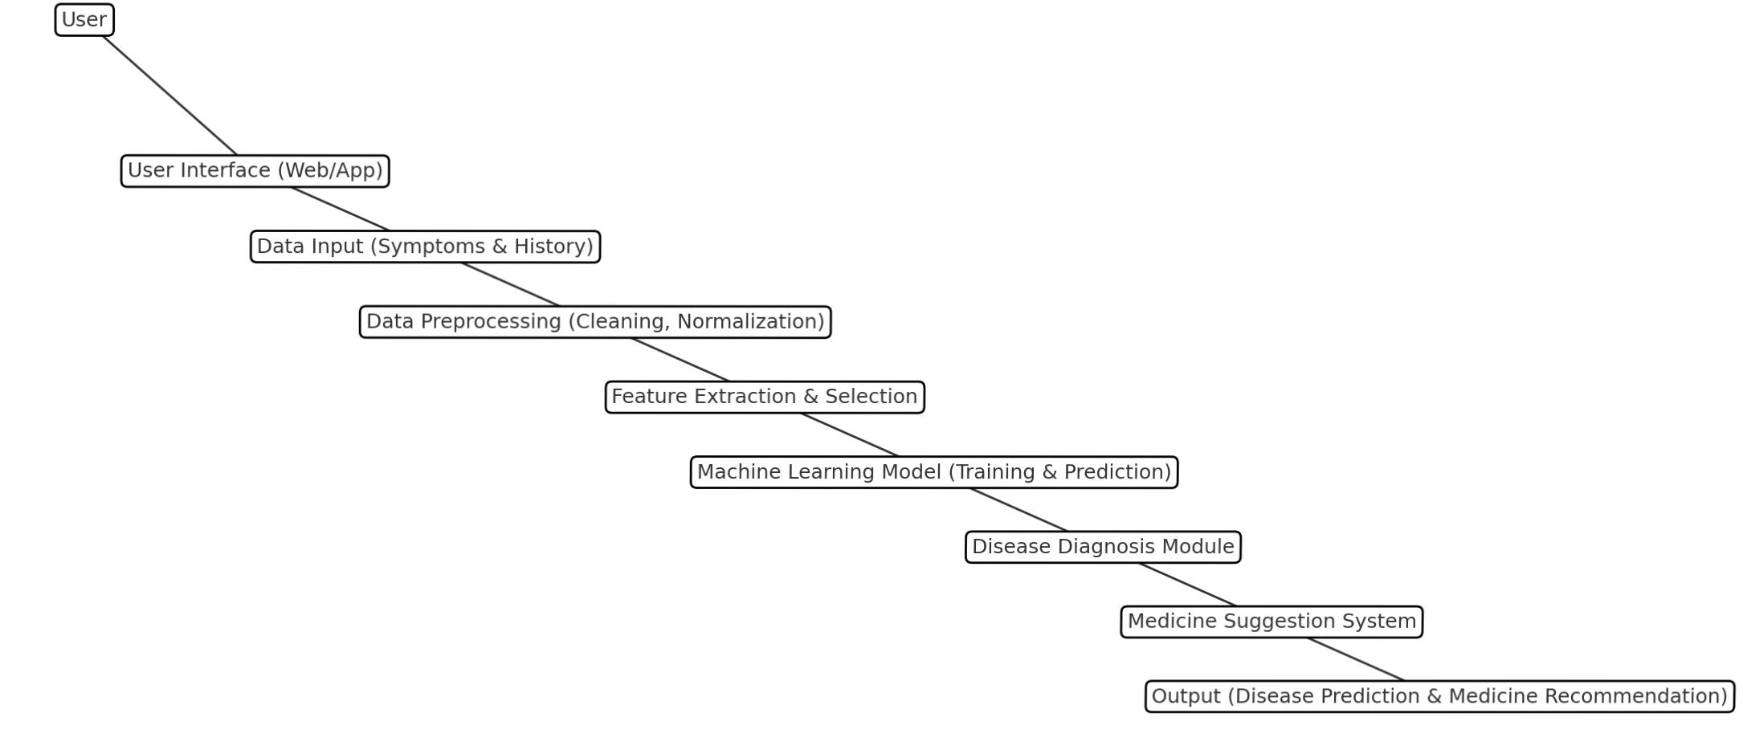
Data Flow Diagram for AI based Disease prediction and suggest medicine

Slide 7
2. LITERATURE SURVEY
1.A Comparative Analysis on Learning Algorithms
Authors: Gokul Unnikrishnan, Ebin K J, George Joseph K, Sreelakshmi
Jayaraj
Published: April 2024
Summary: This paper provides a comparative analysis of various learning algorithms applied to disease prediction and medicine recommendation systems.

Slide 8
2. An Intelligent Disease Prediction and Drug Recommendation System
Authors: G. Gokul, T. Udhayakumar
Published: October 2023
Summary:
This study introduces a system that predicts diseases and recommends drugs based on patient ratings and conditions, utilizing multiple prototypes for disease prediction.

Slide 9
3. A Computer-Based Disease Prediction and Medicine Recommendation System Using Machine Learning Approach
Authors: Jay Prakash Gupta, Ashutosh Singh, Ravi Kant Kumar
Published: 2021
Summary:
This paper introduces a system that uses machine learning to predict diseases and recommend medicines. It aims to help healthcare by providing accurate disease predictions and treatment suggestions, improving early diagnosis and personalized care.

Slide 10
4. Instant Medical Care and Drug Suggestion Service Using Data Mining and Machine Learning-Based Intelligent Self-Diagnosis Medical System
Author: M. Sudha
Published: 2017
Summary:
This paper discusses the Intelligent Self-Diagnosis Medical System (I-SDMS), which automates medical diagnostics using machine learning algorithms. The system evaluates clinical reports and symptoms to provide self-diagnosis and drug suggestions. The methodology focuses on improving accuracy and reducing the need for physical appointments, thus saving time and cost. The results show I-SDMS as a cost-effective and efficient tool for medical practice.

Slide 11
3. PROBLEM IDENTIFICATION
3.1 Challenges in Healthcare Systems
Data Overload – Healthcare generates vast data, making manual analysis inefficient.
Late Diagnosis – Many diseases are detected at advanced stages.
Limited Personalized Treatment – Current systems lack AI-based recommendations.
Incorrect Prescriptions – Medicine recommendations are not always optimized.

Slide 12
3.2 Consequences of Inefficient Disease Prediction
Increased treatment costs due to delayed intervention.
Higher mortality rates in severe conditions (e.g., cancer, heart disease).
Over-prescription or under-prescription of medicines leading to adverse effects.

Slide 13
3.3 Need for an AI-Driven Approach
AI can analyze patient symptoms and predict diseases before severe progression.
ML models can recommend personalized medications based on patient history.

Slide 14
4. AIM & OBJECTIVE
4.1 Aim of the Project
Develop an AI-based disease prediction system
Provide personalized medicine recommendations
Support early diagnosis and preventive care
Ensure data security and privacy

Slide 15
4.2 Objectives
1.⁠ ⁠Early Disease Detection – Identify potential health risks
2.⁠ ⁠Personalized Healthcare Insights – Suggest medicines based on patient data
3.⁠ ⁠Improved Decision-Making – Assist doctors with AI-driven insights
4.⁠ ⁠Data Privacy & Security – Use encryption to protect sensitive data

Slide 16
5. PROPOSED METHOD
5.1 Overview of the Methodology
The proposed system consists of the following stages:
Data Collection & Preprocessing.
Feature Engineering & Selection.
ML Model Training & Optimization.
Medicine Recommendation System.
User Interface & Deployment.
Date of Review: 10-03-2025 Review No:02

Slide 17
5.2 Data Collection & Preprocessing
Data Sources: WHO, Kaggle, hospital databases.
Preprocessing Steps: Handling missing values, normalizing numerical features.
5.3 Feature Engineering & Selection
Selecting relevant symptoms and health parameters.
Using Principal Component Analysis (PCA) to optimize features.
Date of Review: 10-03-2025 Review No:03

Slide 18
5.4 Machine Learning Model for Disease Prediction
Supervised Learning Algorithms:
Decision Trees & Random Forest: Structured classification models.
SVM & Neural Networks: Advanced classification techniques.
Evaluation Metrics:
Accuracy, Precision, Recall, F1-score.
Date of Review: 10-03-2025 Review No:02

Slide 19
5.5 Medicine Recommendation System
Rule-Based System: Matching diseases to standard treatments.
AI-Based System: Learning from patient history & doctor prescriptions.
5.6 System Architecture
Input: Patient symptoms are entered.
Processing: ML model predicts the disease.
Output: Recommended treatment & medicine.
Date of Review: 10-03-2025 Review No:02

Slide 20
6. EXPECTED OUTCOME
6.1 Predicted Results
High-accuracy disease detection.
Efficient and safe medicine recommendations.
Faster decision-making for healthcare professionals.
Date of Review: 10-03-2025 Review No:02

Slide 21
6.2 Benefits of the System
Early detection of diseases reduces risks.
AI-driven prescriptions minimize medication errors.
User-friendly interface for patients & doctors.

Slide 22
THANK YOU

